Slide 1
FORECASTING
STOCKS

Slide 2
Business Objective
Predict the Stock Price for the next 30 days & 365 days (1 Year). There are Open, High, Low and Close prices for a day starting from Year 2000 until 2022 for Reliance Industries. For 365 days, split the last year into a test set to build model, find short term and long term trends, see how it is impacted from external factors or any big external events.
Collaborators: Syed Farhanuddin, Ranjith Samudrala, Jyotsna Thakre,
Vivek Ratan Singh

Slide 3
Index
Introduction
Exploratory Data Analysis (EDA)
Model Building – Forecasting Stocks
Model Deployment

Slide 4
Introduction to Forecasting of Stocks
Forecasting is a Machine learning process that uses algorithms to learn from data and make predictions about future events. For example, to understand audience's needs or predicting the next big trend.
In this project, we are building a model to Forecast Stocks by leveraging multiple forecasting algorithms such as KNN, Random Forest, LSTM (Long Short-Term Memory) and Decision Tree, to name a few, on five components namely, Open, Close, High, Low & Volume.

Slide 5
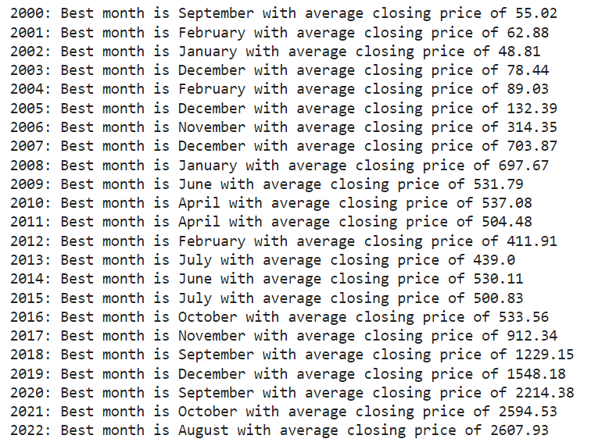
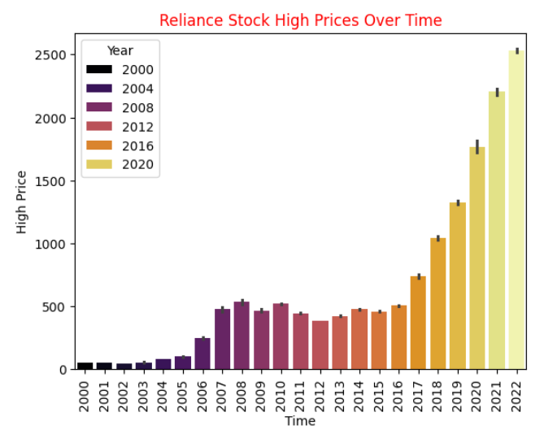
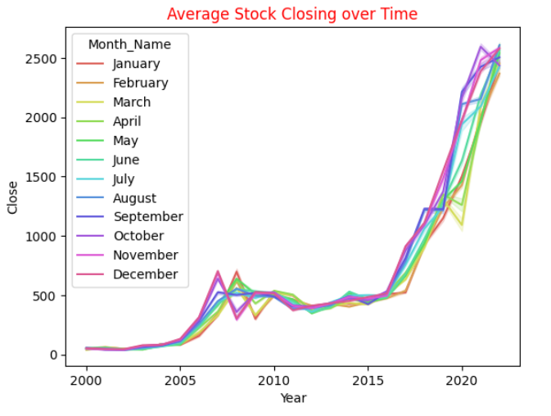
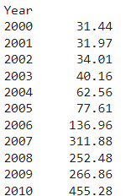
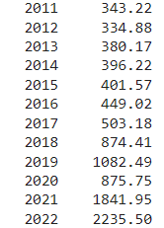
Exploratory Data Analysis (EDA)
Data Analysis and Cleaning
Referring Statistics, Size, Shape, and Type of dataset
Feature Engineering
Box plot for Outliers, it’s Detection and Treatment
Correlation Heatmap
Visualizing other points through Bar graph, Scatter plot, Pie Chart, Line graph and Histogram

Slide 6
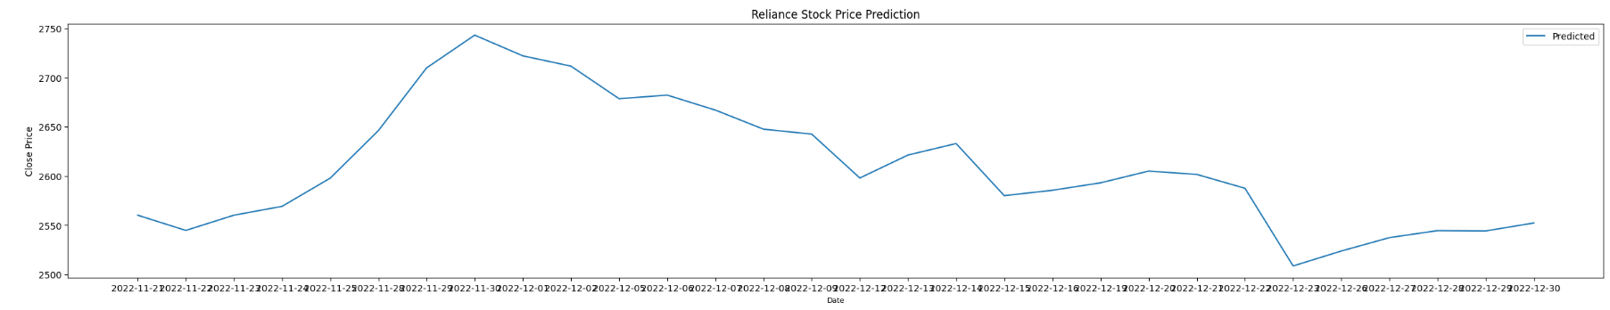
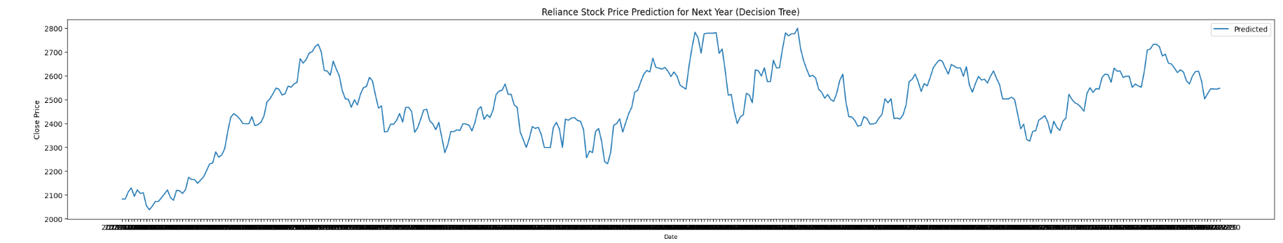
Model Building – Forecasting Stocks
A model captures underlying patterns and relationships of data. Once built, it can be applied to new data to make predictions and obtain results. Some of the leveraged forecasting models are,
K Nearest Neighbours (KNN)
Decision Tree
Long Short-Term Memory (LSTM)
Random Forest
These models are evaluated by
accuracy (100%),
precision (approx. 100%) and
root mean squared error (probable 36).

Slide 7
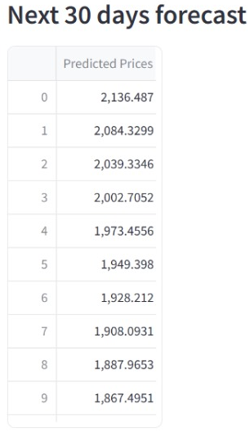
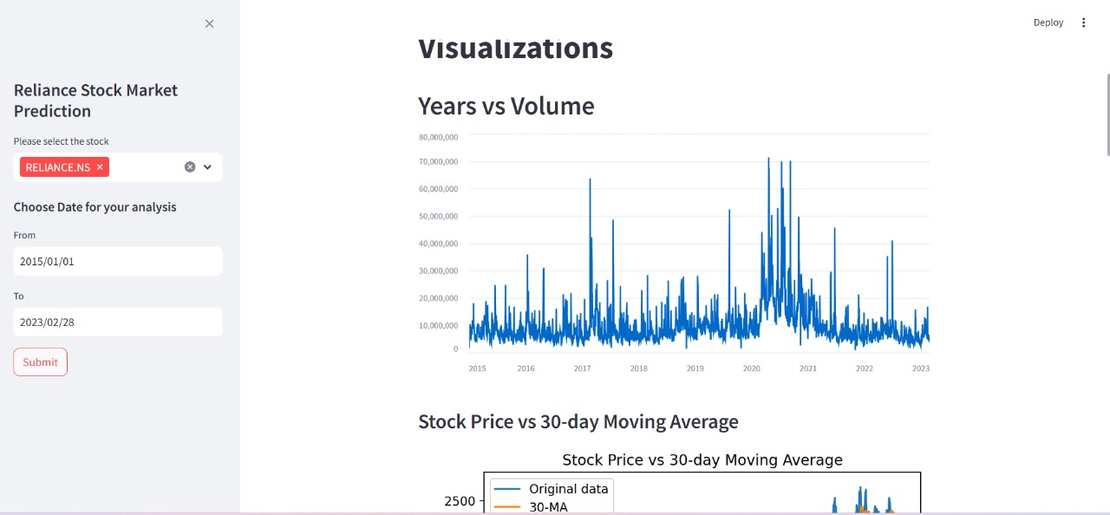
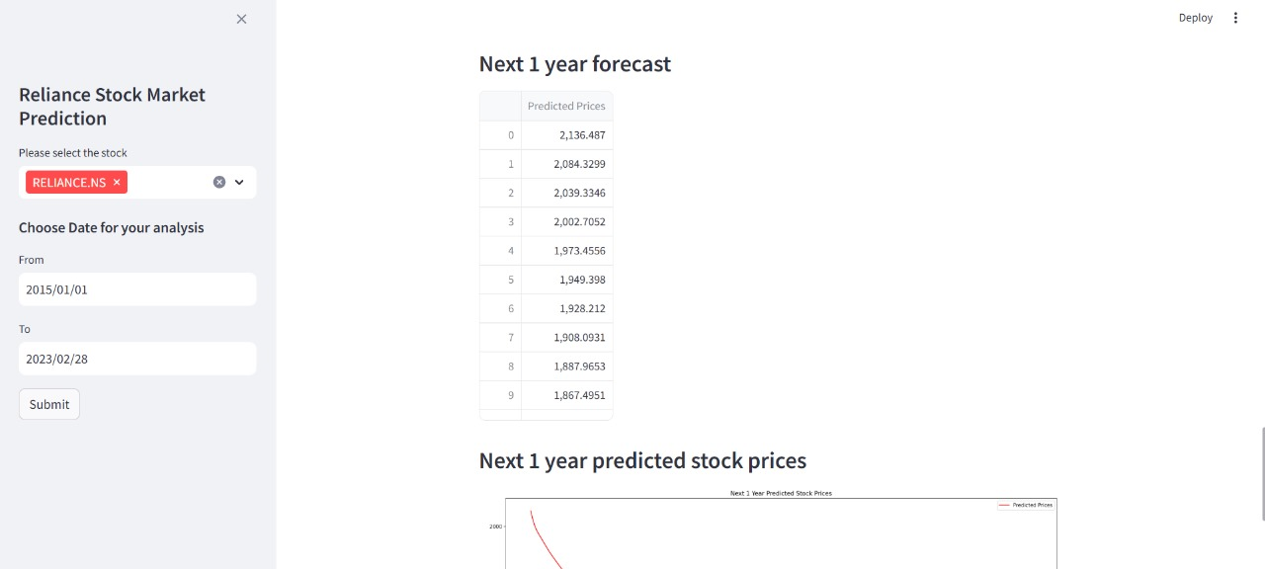
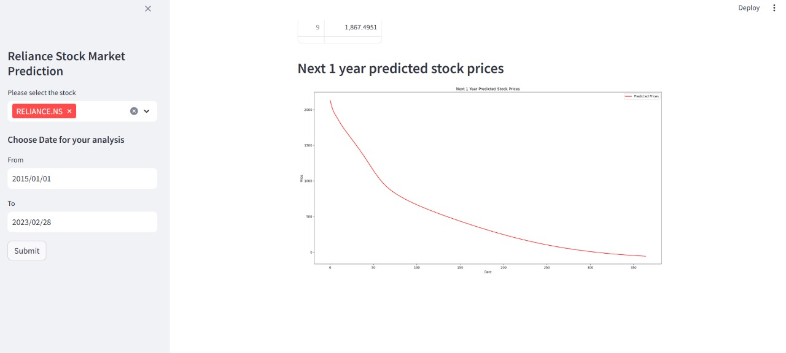
Model Deployment
This is a process of making machine learning models available to users, developers, and systems to assist them in making business decisions based on data, and applications to interact with the model.
In Python, libraries like Pickle or job lib can serialize the model and save it to a file. This file can then be loaded into a Flask application to make predictions.
Pickle: This is primarily used in serializing and deserializing a Python object structure or a process of converting a Python object into a byte stream to store it in a file/database, maintain program state across sessions, or transport data over the network.
Streamlit: This is an open-source Python framework for to deliver dynamic data apps with few lines of code

